Slide 1
Witchcraft:
Black magic of Business Analysis

Slide 2
About me
Business Analyst at AltexSoft
3 years of BA experience in projects of Mining, Safe Internet and Travel domains
Hobby: engagement other to become BAs

Slide 3
Agenda
Who’s BA and how can he make the project better?
Collaboration with the team on the different project phases
Discovery phase: goals, main activities, BA deliverables
How to torture BA?:)

Slide 4
So who’s BA?

Slide 5
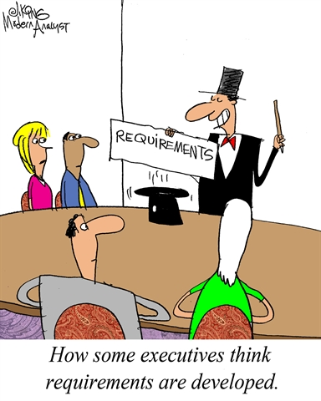
So who’s BA?
Somebody who talks to the customer
Writes requirements
Initiates the meetings. A LOT of meetings

Slide 6
It’s okay without BA…

Slide 7
Here comes BA

Slide 8
The project starts with
Validate the idea
Explain the scope to the Presale process participants
Prepare scope decomposition
Estimate BA efforts for a project
Presale

Slide 9
The most interesting
Understand the business goals and needs
List key problems
Prepare tasks for the first sprints
Presale
Discovery

Slide 10
Project development
Iterative “Discovery”
Team support
Scrum ceremonies
Presale
Discovery
Product development

Slide 11
Maintenance
Product enhancement
Change requests management
Presale
Discovery
Product development
Support and maintenance

Slide 12
Discovery phase
BA tasks
Planning the Discovery
Requirements interview
Artifacts/Deliverables

Slide 13
Discovery: BA tasks
Product idea validation
Identifying key user problems to solve
Preparing a clear product vision

Slide 14
Planning the Discovery

Slide 15
Interview and requirements workshops

Slide 16
Artifacts
Product/Business model/Lean Canvas
As is/To be user flow
Functional decomposition
GIST planning

Slide 17
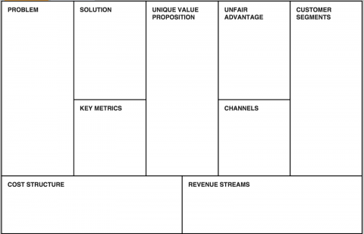
Artifacts -
Canvas

Slide 18
Artifacts - As is user flow

Slide 19
Artifacts - To be user flow

Slide 20
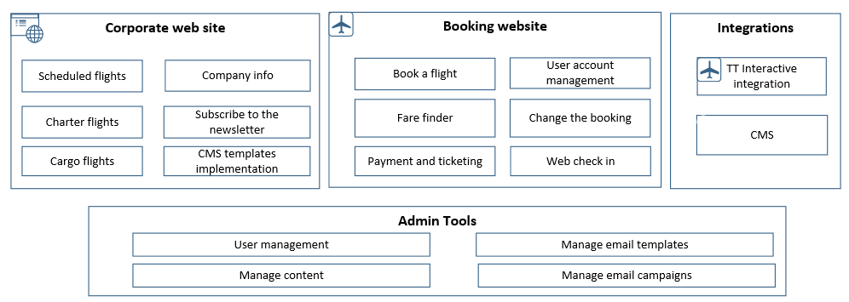
Functional decomposition

Slide 21
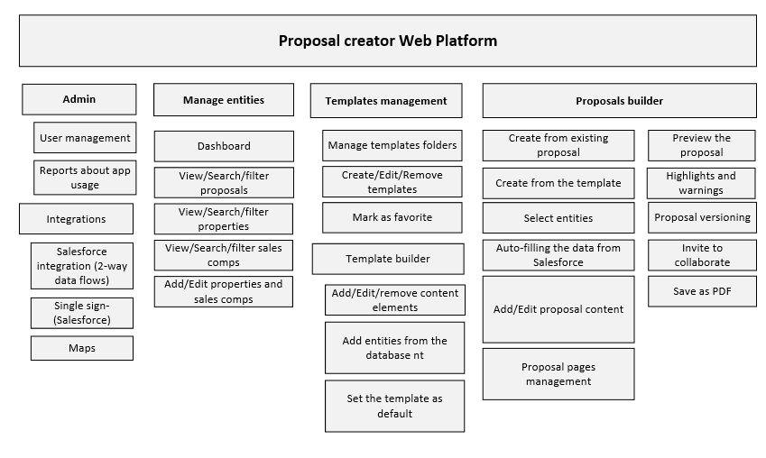
Functional decomposition

Slide 22
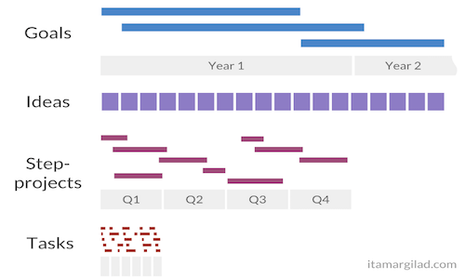
Artifacts: Road Map (GIST Planning approach)

Slide 23
Goals
Ideas
Step-
projects
Tasks
Improve climbing skills
Climb <X> 6000 meters mountains
Everest
Year 1
Year 2
Engage friends
Buy tickets
Plan a vacation
Purchase medical insurance
Watch a movie
Another mountain first?
Get the alpinist certificates
Get doctor/mom/boyfriend allowance
Purchase equipment
Find money
Q1
Q2
Training
More training
Crowdfunding
Friends
Purchase equipment

Slide 24
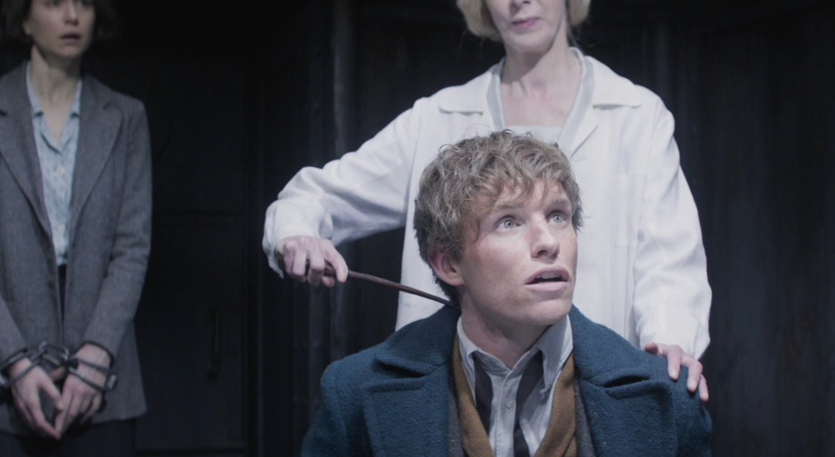
Bored?
Here are some tips how to torture BA:)

Slide 25
If you’re a part of the project team
Tell that “we don’t need ba” - always works
Let somebody else gather requirements (PM, Developer, QA are great for that)
Requirements first (waterfall nightmares)
It wasn’t in the requirements (never ask if you see sth wrong)
Show the BA some code, tell as much tech details as you can
The more refactoring the better. Business value? Nevermind!

Slide 26
If you’re a customer
Good BA should read your mind! Come with some genius solution and keep the problem you wanna solve in secret
We want blockchain/cryptocurrency/IoT/AI/machine learning/big data
Changes after changes (the best during the same sprint)
“The users MIGHT want” (c)

Slide 27
Welcome to the dark side! Become a Business Analyst!

Slide 28
Thank you!

